Slide 1

Why Regulating Technology

Slide 2
Some Examples
Deepfake
Privacy
Water and Natural Resources
Nudges

Slide 3

https://detectfakes.kellogg.northwestern.edu/ What is our score:
Let us try this Experiment

Slide 4
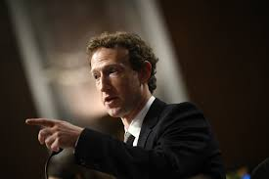
Privacy concerns with Facebook
Meta (formerly known as Facebook), has faced a number of privacy concerns. These stem partly from the company's revenue model that involves selling information collected about its users for many things including advertisement targeting.
In September 2024, the U.S. Federal Trade Commission (FTC) published a report reviewing how nine major companies — including Facebook — collect and use data from both users and non-users, including children and teenagers. The report found that these data practices expose individuals to serious risks, such as identity theft, stalking, discrimination, emotional distress, mental health problems, social stigma, and reputational harm.

Slide 5
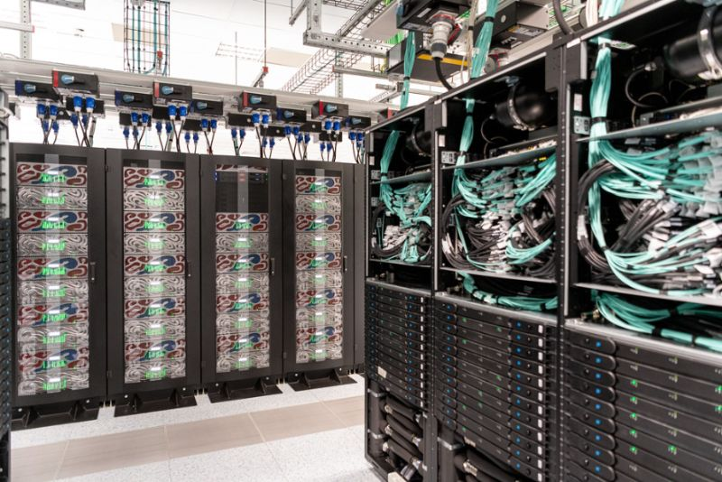
Thirsty for Power and Water
Data center developers are increasingly tapping into freshwater resources to quench the thirst of data centers, which is putting nearby communities at risk.
Large data centers can consume up to 5 million gallons per day, equivalent to the water use of a town populated by 10,000 to 50,000 people.
How much water for one prompt for ChatGPT? (Search in couples)
Notes:
Water and electricity consumption for ChatGPT-4. According to this paper, The Washington Post reported that a 100-word ChatGPT-4 response consumes 519 millilitres of water and 0.14 kWh. This is the basis for our own calculations

Slide 6
Obama’s effort to ‘nudge’ America
Nudging” = using psychology to influence behavior without changing rules.
Example: Making people opt out of organ donation instead of opting in — increases participation.
Goal: Make government policies more effective by adjusting how choices are presented.
Notes:
https://www.politico.com/agenda/story/2015/10/obamas-effort-to-nudge-america-000276/

Slide 7
Obama’s effort to ‘nudge’ America
The Obama administration has been running an experiment: Is it possible to make policy more effective by using psychology on citizens?
President Obama was inspired by behavioral scientists Cass Sunstein and Richard Thaler (authors of Nudge).
Created the Social and Behavioral Science Team (SBST) to test the idea across federal agencies.
1st annual report (after one year) reviewed 15 small “proof-of-concept” projects.
Notes:
https://www.politico.com/agenda/story/2015/10/obamas-effort-to-nudge-america-000276/

Slide 8
What is Bias and Fairness in LLMs? Bias in AI refers to systematic errors or tendencies that a model might make regarding its predictions that unfairly favour one group and disadvantage another.
Gender Bias: Models might associate certain professions with specific genders (e.g., "doctor" with male or "nurse" with female).
Cultural Bias: LLMs trained predominantly in English texts might overlook or misrepresent non-Western cultures.
Economic Bias: The accessibility of LLM tools might favour wealthier regions, excluding underrepresented communities.
Let us try it: Generate a photo of a leader/pilot: https://www.imagine.art/image

Slide 9

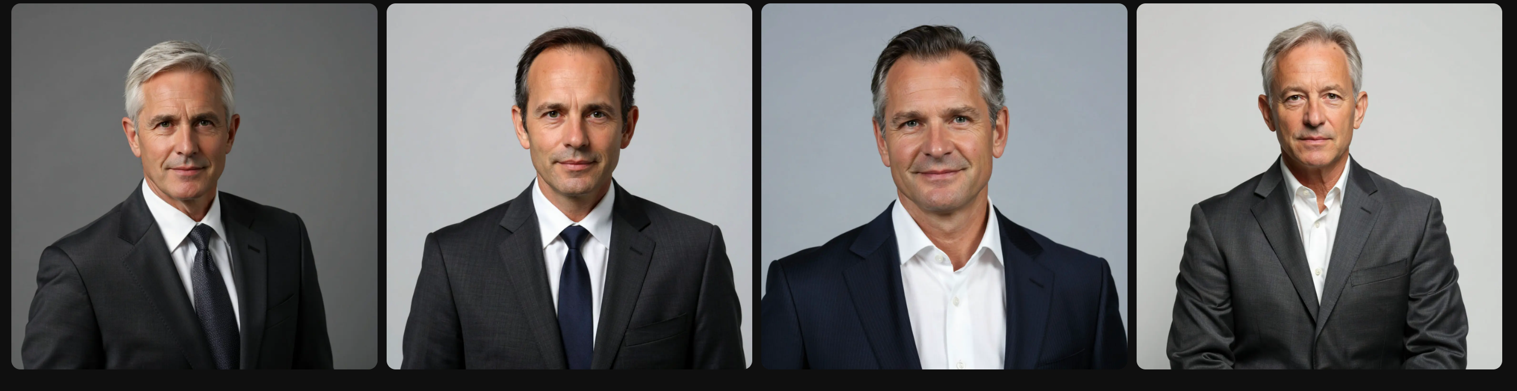
Pilot and Leader: Any Bias?

Slide 10
Why We Need Technology Regulation
To ensure safety and fairness.
To prevent misuse and harm.
To promote ethical innovation.

Slide 11

The EU Artificial Intelligence (AI) Act The AI Act is the first comprehensive regulation on artificial intelligence introduced by a major global regulator — the European Union. It aims to ensure that AI technologies are safe, transparent, and aligned with fundamental rights.
AI Applications Are Classified into Three Risk Categories:
Unacceptable Risk – Banned Applications
AI systems that pose a clear threat to people’s safety, rights, or livelihoods.
High Risk – Strictly Regulated Applications
AI used in areas where errors or bias can have serious consequences.
Example: CV-scanning tools that rank job applicants.
These systems must meet specific legal and ethical requirements (e.g., transparency, oversight, risk management).
Limited or Minimal Risk – Largely Unregulated
Applications not classified as banned or high-risk.
Example: Chatbots, AI-based games, or recommendation systems.
Can you give me an example of Banned Applications?

